Slide 1
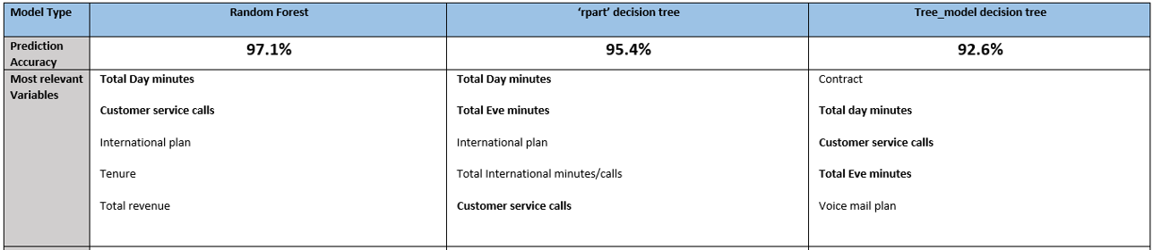
Telco Churn Analysis – Using Tree Based Models
December 2018
Michael DeGrado
Regis University
Data Science Practicum 2 (2018F8W2)

Slide 2
Disclaimer
This project and presentation is a result of work completed as part of a Regis University Data Science class.
Prior to this class my experience with the R language was very limited.
Ideas and recommendations made are based upon my learning during the class and will likely differ from experts who have more experience in machine learning and Data Science.
Video presentation uploaded to Youtube: https://youtu.be/ZVEFfkA9xp4
Github located at: https://github.com/mdegrado/TelcoChurn

Slide 3
Can we use machine learning (ML) to help inform on why customers may have churned and reduce future churn?
14% of the customers in the Telco Churn data set end up leaving (483 of 3,333)
Data from: https://www.kaggle.com/pangkw/telco-churn/version/3
Approach: Use exploratory data analysis (EDA), visualizations and ML to understand data relating to Telco churn. Demonstrate understanding of key churn data variables and provide prediction model for churn.

Slide 4
Approach details, why Tree based model?
Strengths | Weaknesses
An all-purpose classifier that does well on most problems Highly-automatic learning process can handle numeric or nominal features, missing data Uses only the most important features Can be used on data with relatively few training examples or a very large number Results in a model that can be interpreted without a mathematical background (for relatively small trees) More efficient than other complex models | Decision tree models are often biased toward splits on features having a large number of levels It is easy to overfit or underfit the model Can have trouble modeling some relationships due to reliance on axis-parallel splits Small changes in training data can result in large changes to decision logic Large trees can be difficult to interpret and the decisions they make may seem counterintuitive
Lantz, B. (2015)
Why?
The Telco Churn data set has both nominal and numeric features making it a good choice for Tree based models
The data set has the dependent variable of Churn and then 32 other independent variables that can impact churn. With this many independent numeric and nominal variables the Tree based models can handle this type of data.
The Churn question is a business question and the Tree based modeling can be easier to explain to a business audience that might not have a heavy mathematical background.

Slide 5
The Data: 31 features with 3,333 observations, 14% (483) of the total records churned = Yes
Data fields | Definition | Example data
customerID | Unique ID for customer | 0002-ORFBO
gender | has: Male or Female | Female
SeniorCitizen | has: 0 or 1 | 0
MaritalStatus | has Yes or No | Yes
Dependents | has Yes or No | Yes
tenure | ranges from 0 to 72 | 9
PhoneService | all records set to yes | Yes
MultipleLines | has Yes or No | No
InternetService | has DSL, Fiber optic, No | DSL
OnlineSecurity | has No, No Internet service, Yes | No
OnlineBackup | has No, No Internet service, Yes | Yes
DeviceProtection | has No, No Internet service, Yes | No
TechSupport | has No, No Internet service, Yes | Yes
StreamingTV | has No, No Internet service, Yes | Yes
StreamingMovies | has No, No Internet service, Yes | No
Contract | has Month-to-month, One year, Two year | One year
PaperlessBilling | has Yes or No | Yes
PaymentMethod | has Bank transfer (automatic), Credit card (automatic), Electronic check, Mailed check | Mailed check
InternationalPlan | has Yes or No | No
VoiceMailPlan | has Yes or No | No
NumbervMailMessages | ranges 0 to 51 | 0
TotalDayMinutes | ranges 0 to 350.8 | 168.8
TotalDayCalls | ranges 0 to 165 | 137
TotalEveMinutes | ranges 0 to 363.7 | 241.4
TotalEveCalls | ranges 0-170 | 107
TotalNightMinutes | ranges 23.2 to 395 | 204.8
TotalNightCalls | ranges 33 to 175 | 106
TotalIntlMinutes | ranges 0 to 20 | 15.5
TotalIntlCalls | range 0 to 20 | 4
CustomerServiceCalls | ranges 0 to 20 | 0
TotalCall | ranges 194 to 418 | 354
TotalRevenue | ranges 18.8 to 8476.5, 5 NA's | 593.3
Churn | has Yes or No | No

Slide 6
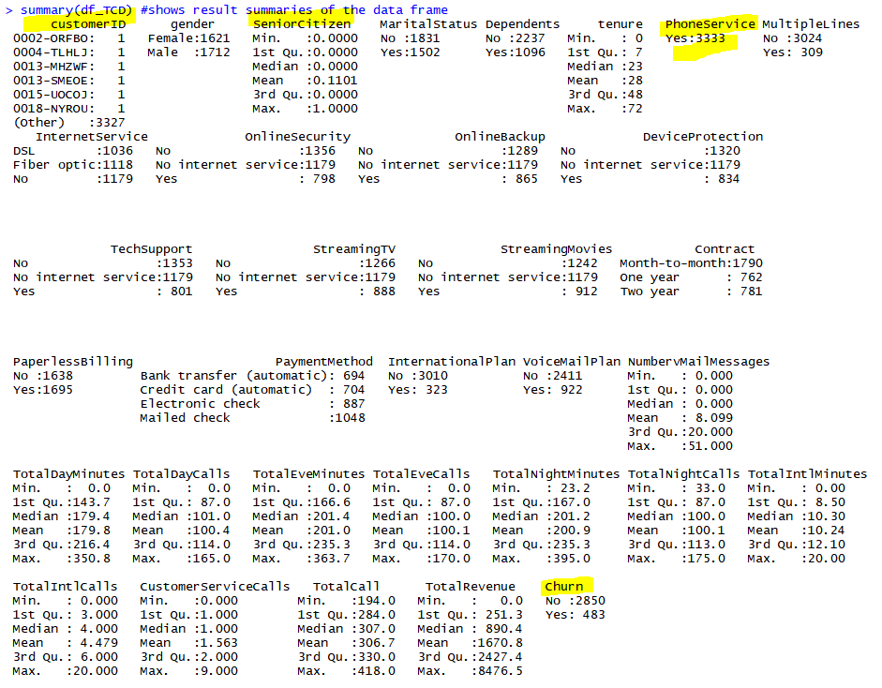
Exploratory Data Analysis (EDA)
Discussion:
Most boolean categorical variables were set to Yes or No in the data with exception of Senior Citizen which was 1 or 0.
Prior to modeling set this to Yes or No for consistency with other data.
Removed the PhoneService column prior to modeling because it is always set to Yes and therefore isn’t really needed.
Removed the CustomerID column prior to modeling as it is identity column and the modeling already handles this
Churn is set as dependent variable during modeling

Slide 7
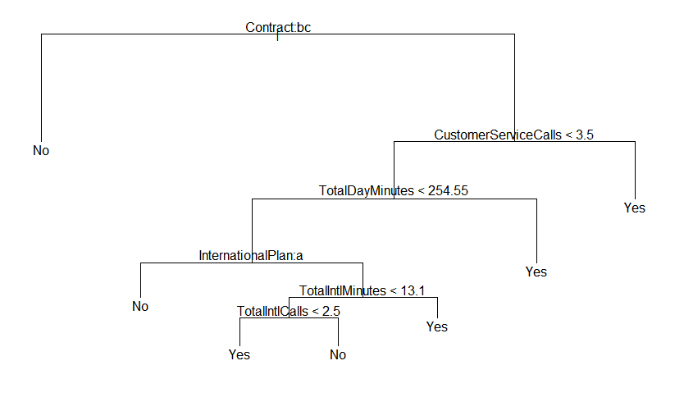
Modeling Results of Customer Churn and Confusion Matrix – Tree Model
Tree Model: Churn |  | Predicted
 |  | No | Yes
Actual | No | 1,371 | 54
 | Yes | 68 | 174
Total 1,667
Breakdown
- Agreement between actual and predicted
- Prediction not matching actual
Result: 1371+174=1545 Correct, 1545/1667
= 92.6% Accuracy

Slide 8
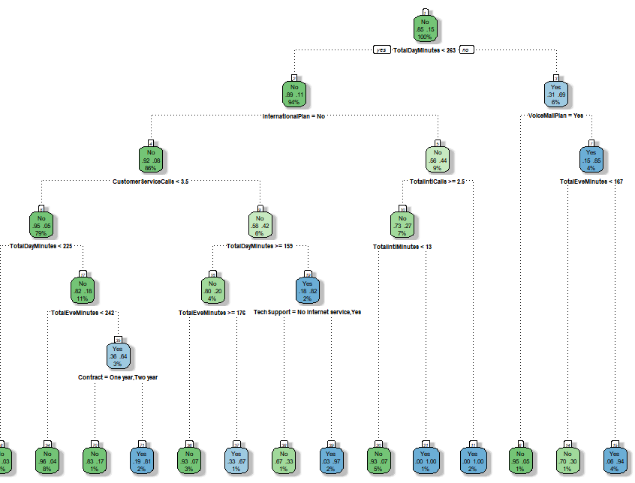
Modeling Results of Customer Churn and Confusion Matrix – rpart Tree Model
Rpart: Churn |  | Predicted
 |  | No | Yes
Actual | No | 1,409 | 16
 | Yes | 60 | 182
Total 1,667
Breakdown
- Agreement between actual and predicted
- Prediction not matching actual
Result: 1409+182=1591 Correct, 1591/1667
= 95.4% Accuracy

Slide 9
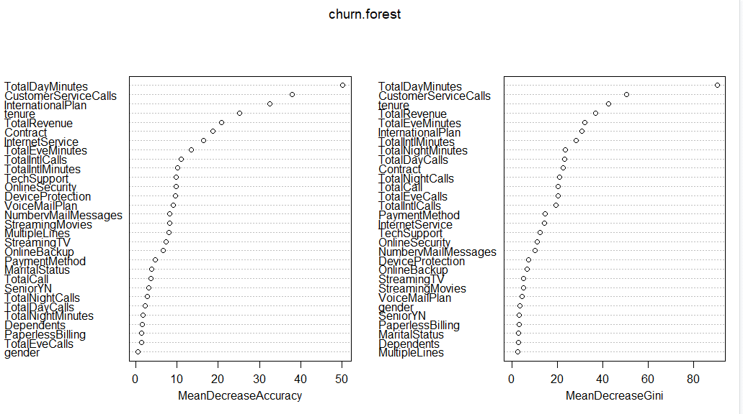
Modeling Results and Confusion Matrix – Random Forest Model
Random Forest: Churn |  | Predicted
 |  | No | Yes
Actual | No | 1,970 | 31
 | Yes | 132 | 200
Total 2,233
Breakdown
- Agreement between actual and predicted
- Prediction not matching actual
Result: 1970+200=2170 Correct, 2170/2233
= 97.1% Accuracy
Most relevant variables:
Some elements matched the simple decision tree models:
Total Day Minutes
Customer Service Calls
International plan

Slide 10
Summary and Recommendations
Recommendations and usage scenarios:
The models could be used on new customers to understand if they may be more likely to churn
The models agree on many of the same data elements having significance to churn
a. Understand and promote those features that are significant factors to churn behavior.

Slide 11
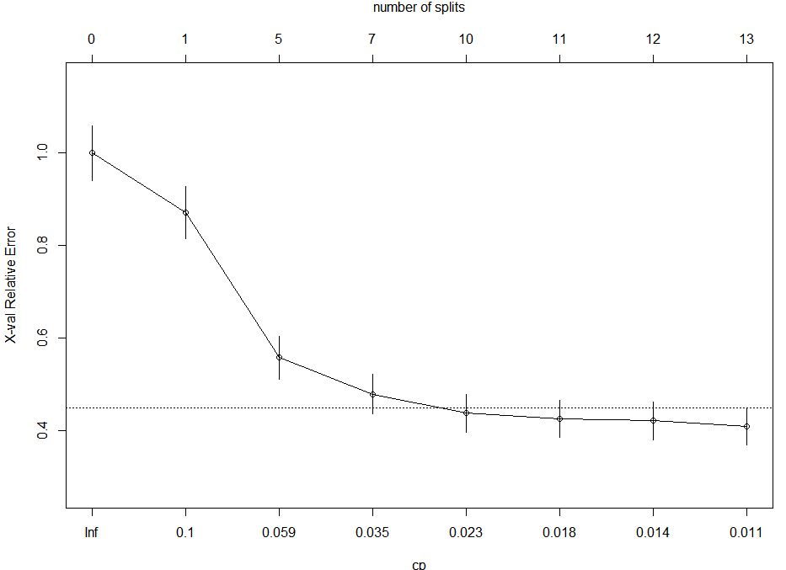
Model tuning
Model Type | Random Forest | ‘rpart’ decision tree | Tree_model decision tree
Tuning Technique | Tried changing number of trees generated to lower and higher. Going from 500 to 600 increased error rates. Going from 500 to 400 also increased error. Sweet spot is around 500 | Major improvements end after 7 splits. | Pruned based on tree split analysis. Pruned to best option of 9 splits. pruning improved accuracy error from .07318536 to .0718572 Final result model improvement to 92.8% accuracy from 92.6%
Major improvements stopped after 7 splits for the decision trees

Slide 12
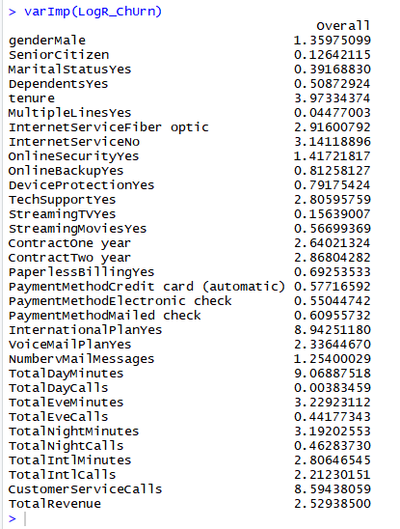
Logistics regression
The Logistics regression model also agrees on many variables with the other Tree based models. Ranking the overall top important variables in this order:
Total day minutes
International plan
Customer Service Calls
Tenure
Total Eve Minutes

Slide 13
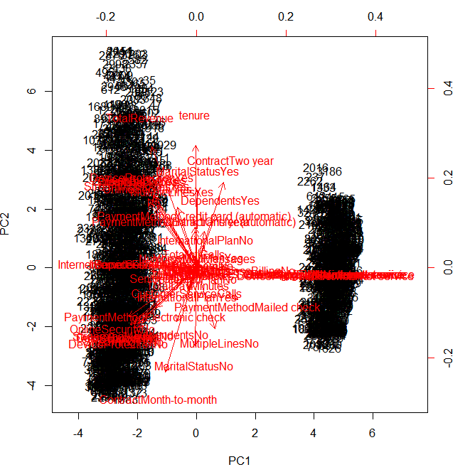
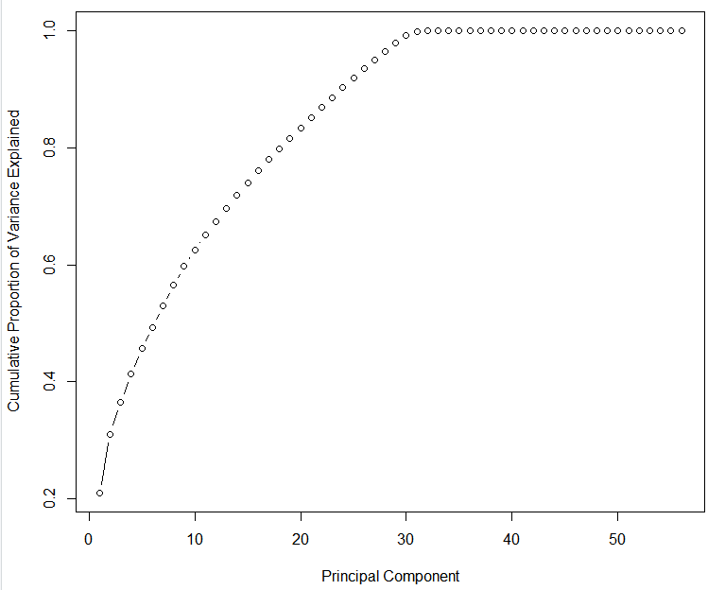
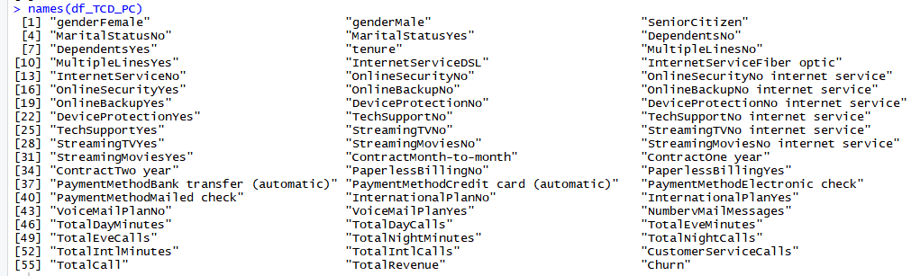
Principal Component Analysis (PCA)
PCA:
PCA was extremely helpful in looking at the variables.
Next steps mentions taking this approach and sending them into the decision tree.
Was able to begin the decision tree with PCA’s but didn’t get all the way through to testing accuracy or variable importance.

Slide 14
Follow up work
Follow up and additional recommended work:
Principle Component Analysis (PCA) code is included and working
Next step of combining (ensemble) the PCA and sending PCA data in the Tree based models
Logistics regression code is included.
Model was run but accuracy was so low that it isn’t included in the results
Accuracy could be low because of the number of independent variables in the data.
Research indicated that with so many independent variables the Tree based models would be the best approach for machine learning.

Slide 15
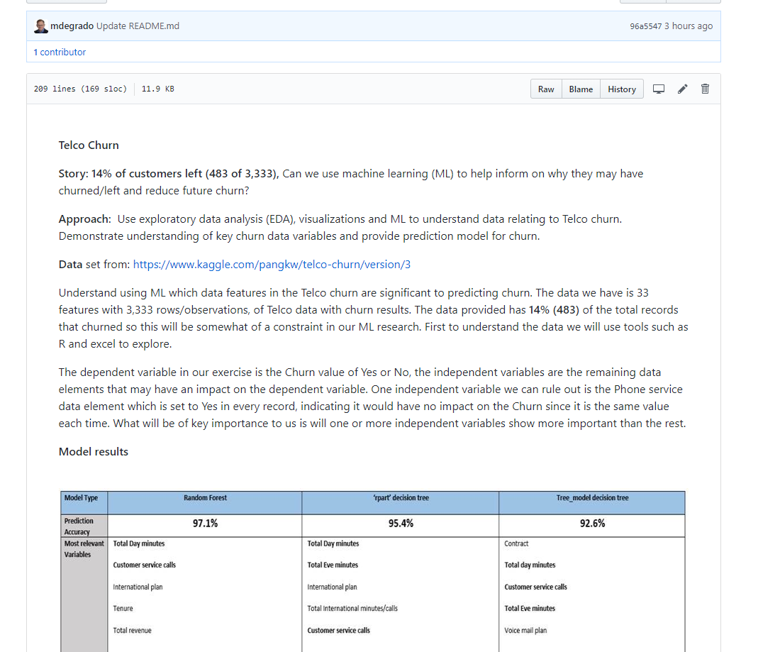
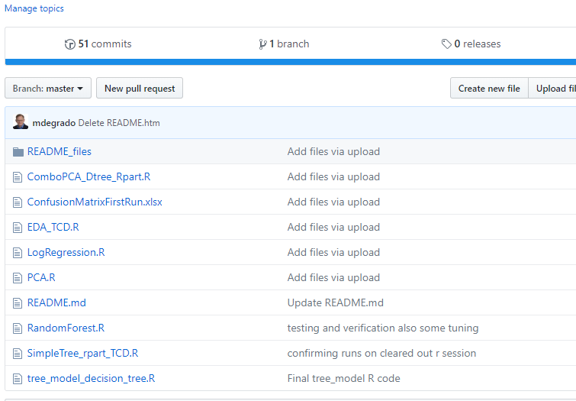
Github
https://github.com/mdegrado/TelcoChurn/blob/master/README.md

Slide 16
Retrospective / Lessons learned
Using web examples:
Several examples researched looked promising until trying them in my specific circumstance and then getting the code to relate or be used in with the data I was using was often time consuming.
Using book examples:
Super helpful book examples were researched and setup with more detail and background to explain the subject often better than the web examples. Often would take a combination of books on the specific topic to cobble together a full picture.
Using Youtube:
Similar to web examples, youtube was helpful but often related to specific scenario. Some nuggets like comments during a youtube coding session would often provide details a book or reading a web page might leave out.
PCA- Was recommended by the professor: I was able to get the PCA started and running.

Slide 17
References
Books:
Cirillo, A. (2017). R Data Mining. Birmingham, UK. Packt Publishing
Lantz, B. (2015). Machine Learning with R - Second Edition. Birmingham, UK. Packt Publishing
Schmuller, J. (2018). R Projects For Dummies. Hoboken, NJ. John Wiley & Sons Inc.
Web Sites
PCA example https://www.analyticsvidhya.com/blog/2016/03/practical-guide-principal-component-analysis-python/
Logistic regression sample https://www.r-bloggers.com/how-to-perform-a-logistic-regression-in-r/
Tree based modeling tutorial https://www.analyticsvidhya.com/blog/2016/04/complete-tutorial-tree-based-modeling-scratch-in-python/
Titanic Tutorial for R uses cool examples and graphics for decision trees: https://trevorstephens.com/kaggle-titanic-tutorial/getting-started-with-r/
Example project from past practicum that I am using as a layout reference: https://github.com/KeanuNotReeves/practicum-trad-projections
Basic R example for decision tree: https://rpubs.com/SANPANDE/221595
Github for Practicum 2: https://github.com/mdegrado/TelcoChurn - In Progress
Github for Practicum 1: https://github.com/mdegrado/Wine-reviews-analysis-and-visualization:

